Slide 1

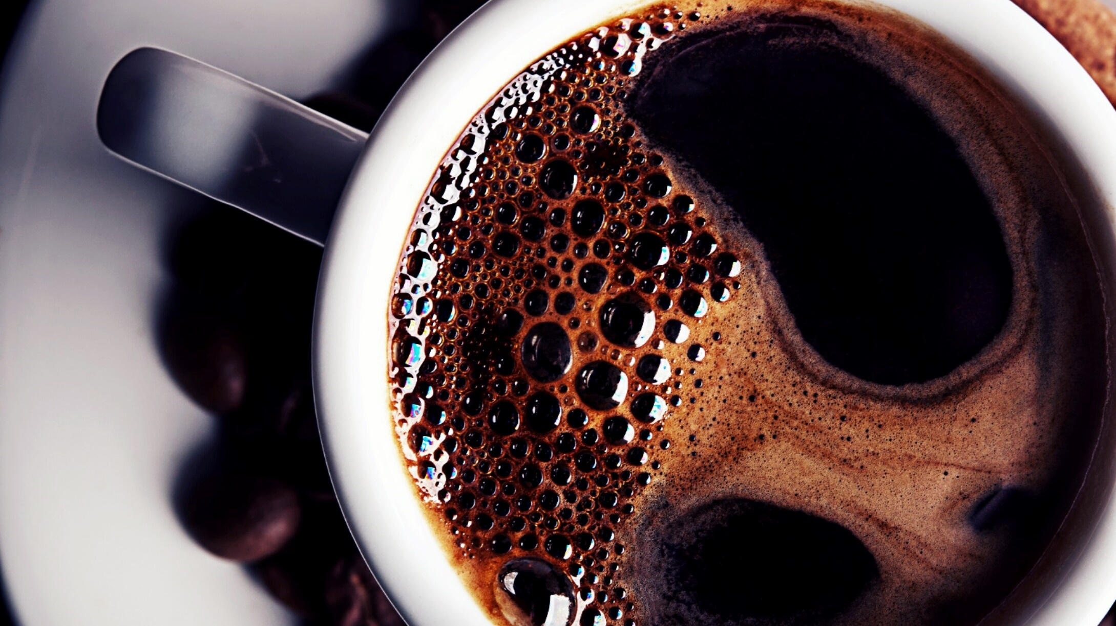
DISCOVER NATURAL GROUPINGS Assignment 4 Unsupervised Machine Learning Kmeans & Dimensionality Reduction using PCA) palmerpenguins::penguins dataset
KIBIDI K. LERENCER| 00/04/2026 Chuka University: Center For Data Analytics And Modeling Registration No: CDAM/0047/2026 Instructor: LEC VICTOR WANDERA

Slide 2
Executive Summary
The main aim of this project was to apply unsupervised learning (K-Means &dimensionality reduction using PCA) to the Palmer Penguins dataset to discover natural morphological groupings without using species labels.
Thepalmerpenguins dataset contains morphological measurements for 344 penguins from three species (Adelie, Chinstrap, Gentoo) across three islands in the Palmer Archipelago, Antarctica. only numeric morphological variables for unsupervised pattern discovery.
Elbow method and silhouette analysis strongly supported 3 clusters(Optimal Clusters (k=3) .
The 3 discovered clusters aligned with the 3 known penguin species (Adelie, Chinstrap, Gentoo).
The first 3 Principal Components explained ~95% of variance, with PC1 representing "body size" and PC2 representing "bill shape."
The Average Silhouette Width = 0.446 which is reasonable
K-Means successfully discovered biologically meaningful groups. PCA preserved the cluster structure while reducing dimensionality.

Slide 3
Analysis Workflow
Data Import & Exploration → Load data, check structure, handle missing values.
Preprocessing → Select numeric variables, scale to mean=0, sd=1.
EDA → Pairs plot, boxplots, correlation matrix.
Find Optimal k → Elbow method + Silhouette analysis.
Fit K-Means → Run model with k=3, extract clusters.
PCA → Dimensionality reduction, scree plot, biplot.
Combine K-Means + PCA → Cluster on PC1/PC2, compare results.
Validation → Silhouette, Dunn, Calinski-Harabasz indices.
Biological Interpretation → Link clusters to species, interpret loadings.
Report Synthesis → Summarize findings, recommendations

Slide 4
Task 1: Data Import and Exploration
The required libraries (tidyverse, palmerpenguins, cluster, factoextra, ggplot2, dplyr, mclust )were loaded.
The built-in dataset: palmerpenguins::penguins was loaded.
The set has 3 major species(Adelie, Chinstrap, Gentoo) from 3 islands (Biscoe, Dream, Torgersen),
The dataset has 8 columns namely: species, island, bill length , bill depth, flipper length, body mass, sex and year
The means are bill length is 43.92, bill depth is 17.15, flipper length :200.9, body mass: 4202 over 2007-2009.
bill length, bill depth, flipper length all have a total of 2 missing values while gender had 11 missing values which were all dropped reducing the observations to 333 and 8 variables.

Slide 5
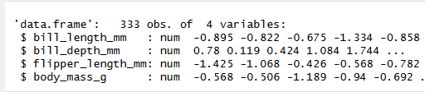
Task 2: Data Preprocessing
The Structure of penguin_scaled end results of data preprocessing
Data preprocessing included;
*Dropping missing data
*Identifying numeric variables
*Scaling numeric variable and standardizing the mean and standard deviation this is meant to prevent variables with larger ranges (e.g., body mass(g) from dominating the analysis as K-Means and PCA use Euclidean distance.
*Scaling ensures each variable contributes equally.

Slide 6
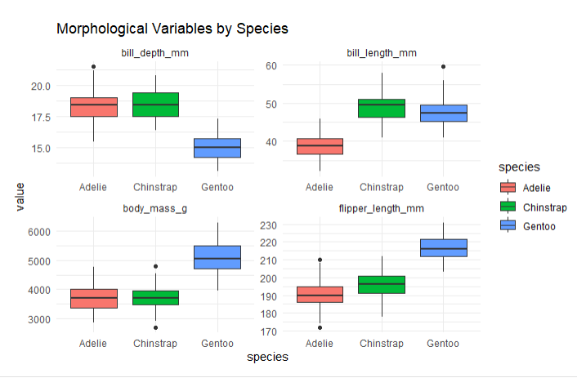
Task 3: Exploratory Data Visualization
Flipper length has strong correlation with both bill length(r=65) and body mass (r=0.87) which shows clear separation between all the 3 species.
Body mass has High correlation with flipper length (r=0.87); Gentoo are distinctly heavier (>4700g) while Adelie/Chinstrap overlap less
Bill depth has Negative correlations with other variables; uniquely distinguishes Chinstrap (shallow bill ~16mm) from Adelie (deep bill ~18mm)
Bill length has Moderate correlations; some overlap between Adelie (37-40mm) and Chinstrap (46-50mm), but still useful
Flipper length + bill depth together provide complementary (nearly orthogonal) information and together classify all three species with minimal error.

Slide 7
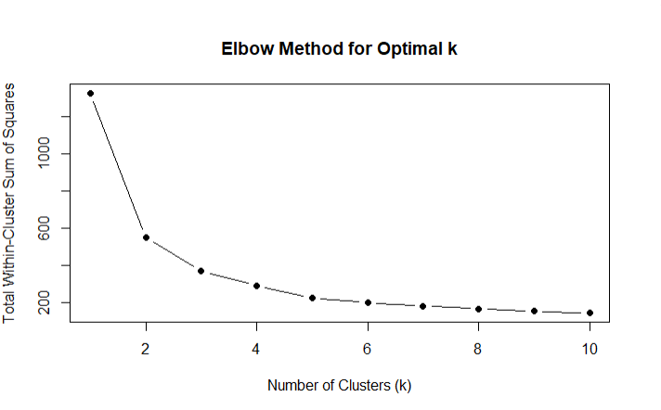
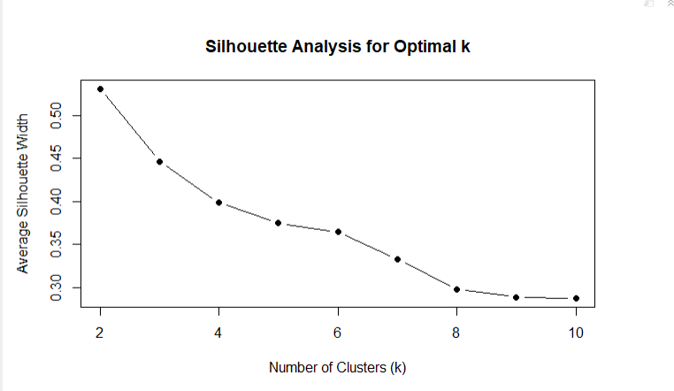
Task 4: K-Means: Finding Optimal K
*The elbow method showed the rate of decrease sharply changes between 2 and k making a bend thus at k=3, indicating diminishing returns in within-cluster sum of squares beyond this point.
*Total Within-Cluster Sum of Squares (WSS): 369.65
The silhouette analysis : the number of clusters were tested from 2 to 10 , the highest average silhouette width (0.45) achieved at k=3, indicating reasonable cluster structure.
*Average Silhouette Width: 0.446
*k=3 was selected as the optimal number of clusters for from both silhouette analysis and elbow method for subsequent analysis.

Slide 8
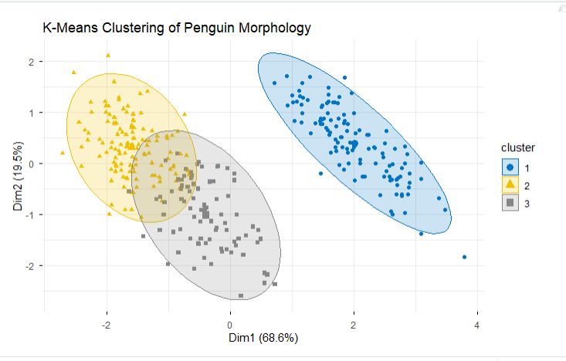
Task 5: K-Means: Model Fitting and Cluster Profiling
The model parameters used were, k=3, n-start=25, WSS=369., Silhouette =0.446 for model filling and cluster profiling.
Cluster | Size | Body Size | Bill Depth | Bill Length | Flipper | Mass (g) | Species Match
1 | 119 | Large | Shallow | Long | Long (217) | 5092 | Gentoo
2 | 129 | Small | Medium | Short | Short (189) | 3594 | Adelie
3 | 85 | Medium | Deep | Long | Medium (197) | 3898 | Chinstrap

Slide 9
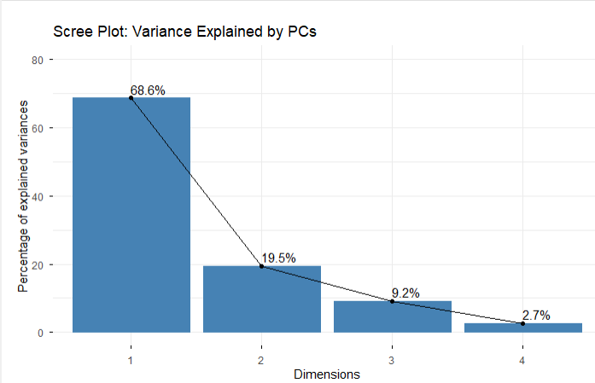
Task 6: Principal Component Analysis
8PCA on the 4 scaled morphological variables to reduce dimensionality & visualize underlying structure showed:
(PC1: 68.6%, PC2: 19.5%), explained 88.1% of the total *variance with three components needed to reach the 90% threshold (cumulative 97.3%).
PC1 had strong positive loadings from flipper length (0.58) & body mass (0.55), representing an "overall body size" component that separates large-bodied Gentoo penguins from smaller Adelie and Chinstrap.
*PC2 was dominated by bill depth (-0.80), representing a "bill shape" component that distinguishes Adelie (deep bill) from Chinstrap and Gentoo (shallow bills).
*The scree plot showed a clear elbow after PC2, confirming that two components effectively the variation underlying the three K-Means clusters.
* Overall, PCA successfully reduced four dimensions to two while preserving 88% of the information, enabling effective visualization of the natural groupings in the data.

Slide 10
Task 7: Combining K-Means and PCA
PCA reduced four morphological variables to two principal components explaining 88.1% of total variance. PC1 (68.6%) represents body size (flipper length and mass), while PC2 (19.5%) represents bill shape (bill depth).
The scree plot confirmed two components effectively capture the variation underlying the three K-Means clusters.
 | PCspace |  |  | Agreement: 320/333 (96%)
FullSpace | 1 | 2 | 3
1 | 119 | 0 | 0 | Cluster 1: 100% match
2 | 0 | 119 | 10 | Cluster 2: 92% match
3 | 0 | 3 | 82 | Cluster 3: 96% match
PCA successfully preserves cluster structure, while enabling 2D visualization of the 3 clusters.

Slide 11
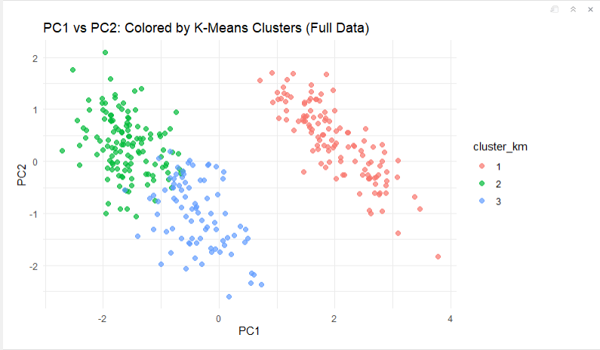
Task 8: Cluster Validation and Quality Assessment
Three internal metrics evaluated for k=3 solution. *Silhouette (0.446) indicates weak-to-reasonable structure. Clusters are defined but have some overlapin Clusters 2 and 3 (Adelie/Chinstrap)
*Dunn index (0.037) suggests moderate separation. Minimum inter-cluster distance is small relative to intra-cluster spread
CH index (427.8) supports the 3-cluster solution despite a peak at k=2. the index is good Between-cluster variance is high relative to within-cluster variance
• Validation supports biological reality of 3 penguin species

Slide 12
. Summarize your complete workflow.
1.Ideentifying the main objective of the assignment
2.Data Preparation
Loaded Palmer Penguins dataset (344 penguins, 8 variables)
Removed 11 rows with missing values → 333 complete cases
Selected 4 morphological variables: bill: length,depth, flipper length, body mass
Scaled all variables to mean=0, SD=1 (critical for distance-based
3.K-Means Clustering:
Determined optimal k using elbow method and silhouette analysi
Elbow showed bend at k=3; silhouette peaked supported k=3
Fit final K-Means model with k=3, nstart=25 for stability
Added cluster assignments to original dataset
Profiled clusters using centroids and original-scale means
4.Principal Component Analysis:
Performed PCA on scaled data to reduce dimensionality
First 2 PCs explained 88.1% of variance; 3 PCs reached 97.3%
Interpreted loadings: PC1 = body size, PC2 = bill shape
5. Validation:
Internal metrics: Silhouette (0.446), Dunn (0.037), CH Index (427.8)
External validation: Compared clusters to species (ARI = 0.799)
PCA + K-Means comparison: 96% agreement between original and PCA-reduced space.
6.interpretation /evaluation

Slide 13
Justification
Yes, K-Means discovered biologically meaningful groups. Despite moderate silhouette score, the clusters strongly correspond to actual penguin species, demonstrating that K-Means successfully discovered natural groupings without using species labels.
Evidence | Finding | Justification
Adjusted Rand Index | 0.799 | Strong agreement with known species
Contingency Table | Cluster 1 = 100% Gentoo, Cluster 2 = 96% Adelie, Cluster 3 = 74% Chinstrap | Clear species alignment
Cluster Profiles | Distinct morphological patterns across 3 clusters | Biologically interpretable
PCA Visualization | Clusters separate in PC1-PC2 space | Visual confirmation
Silhouette Width | 0.446 (weak-to-reasonable) | Acceptable internal structure

Slide 14
Task 9: Interpretation and Biological Insights
*The 3 K-Means clusters aligned closely with known penguin species: Cluster 1 (Gentoo, 119 birds) , Cluster 2 (Adelie, 124 birds) and Cluster 3 (Chinstrap, 63 birds) with intermediate traits.
* PC1 represented body size (68.6% variance), PC2 represented bill shape (19.5% variance).
*The clusters validate biological realism.
Feature | Cluster 1 | Cluster 2 | Cluster 3
Body Size | Large | Small | Medium
Bill Depth | Shallow (15.0 mm) | Medium (18.1 mm) | Deep (18.7 mm)
Bill Length | Long (47.6 mm) | Short (38.3 mm) | Long (47.7 mm)
Flipper Length | Long (217 mm) | Short (189 mm) | Medium (197 mm)
Body Mass | Heavy (5092 g) | Light (3594 g) | Medium (3898 g)
Size (n) | 119 | 129 | 85
Dominant Species | Gentoo | Adelie | Chinstrap

Slide 15
Recommendations
For wildlife biologist How could choose to use these unsupervised model I would recommend:
Always scale variables before clustering (body mass in grams will dominate bill depth in mm)
Use multiple methods (Elbow + Silhouette + CH index) to determine optimal k
Validate with domain knowledge - clusters must make biological sense
Combine with PCA for 2D visualization and communication to non-experts
Interpret clusters conservatively - they suggest patterns, not absolute truths
Test stability by running clustering multiple times with different seeds

Slide 16
Trade-offs:
Considering the Original space is bigger than PCA, the major trade off is in relation to space : more info, harder to visualize
Aspect | Original Space | PCA-Reduced Space
Information | 100% of variance | 88% (PC1+PC2) or 97% (PC1-3)
Interpretability | Direct variable meanings | Linear combinations of variables
Visualization | Impossible (>3D) | Easy (2D plots)
Computation | Slower (4 dimensions) | Faster (2 dimensions)
Noise sensitivity | Higher (includes all noise) | Lower (filters noise)
Cluster shape assumption | Spherical (K-Means) | Better for elongated clusters

Slide 17
Original space vs PCA reduced space
As per the confusion matrix -PCA preserved cluster structure almost perfectly while reducing 4 dimensions to 2, enabling effective visualization and faster computation.
When to prefer original space: | When to prefer PCA-reduced space:
When all dimensions are equally important | For visualization and exploration
When you need variable-level interpretability | When dealing with high-dimensional data (10+ variables)
When PCA would lose critical variance (<70% captured) | To remove noise and multicollinearity
When sample size is very small | When speed is a priority

Slide 18
Limitations & Assumptions
LIMITATIONS
Some misclassification –Due to overlapping features- spherical clusters
Unequal cluster sizes leading to Bias toward larger clusters
Failure to tackle outliers who Can distort centroids
Risk of over-clustering
ASSUMPTIONS
Silhouette assumes spherical clusters - penguin data may have elongated shapes
Dunn index sensitive to outliers - can be misleading with noisy data
CH index favors convex clusters - may not capture complex natural groupings
All internal metrics lack ground truth - should be complemented with biological validation

Slide 19
Task 10: Report Synthesis
Unsupervised learning successfully identified │ │ penguin morphotypes matching species, validating the approach │ │ for ecological field studies where labels are unknown.
Unsupervised learning successfully identified
penguin morphotypes matching species, validating the approach
for ecological field studies where labels are unknown.
KEY FINDINGS:
✓ K-Means discovered biologically meaningful groups (3 species)
✓ PCA preserved 96% of cluster structure in 2D
✓ Unsupervised learning works without labels
Recommendations for future work:
Try hierarchical clustering (no spherical assumption)
Use t-SNE or UMAP for non-linear dimensionality reduction
Include sex and island as additional features
Validate on independent dataset (e.g., penguins_raw with more years)
Use ensemble clustering to assess stability

Slide 20
Conclusion
This unsupervised learning analysis successfully identified three morphological groups in the Palmer Penguins dataset that correspond closely to the three known species (Adelie, Chinstrap, Gentoo). K-Means clustering with k=3 produced an Adjusted Rand Index of 0.799 when compared to true species labels. PCA reduced four morphological variables to two principal components explaining 88.1% of variance, with PC1 representing body size (flipper length and mass) and PC2 representing bill shape (bill depth).
The cluster structure was preserved with 96% agreement when reapplied in PCA space. Internal validation metrics (silhouette=0.446, Dunn=0.037, CH=427.8) indicated reasonable cluster quality. These methods are recommended for wildlife biologists working with unlabeled field data, though users should be aware of K-Means' assumptions of spherical clusters and PCA's linearity constraints.

